Slide 1
Introduction To AJAX

Slide 2
Part 1: Introduction to AJAX
What is AJAX?
Why AJAX is needed?
How AJAX changed web development?
Traditional Web Request vs AJAX Web Request
Where AJAX is used today?

Slide 3
What is AJAX?
Asynchronous JavaScript and XML
Allows web pages to update asynchronously by exchanging data with server
No full page reload required

Slide 4
Why AJAX?
Improves user experience
Faster interactions
Reduced bandwidth consumption

Slide 5
Impact of AJAX on Web
Shifted from static to dynamic web apps
Enabled Single Page Applications (SPA)
Examples: Gmail, Google Maps, Facebook

Slide 6
Traditional vs AJAX Requests
Traditional: Full page reload
AJAX: Only data transferred, page stays

Slide 7
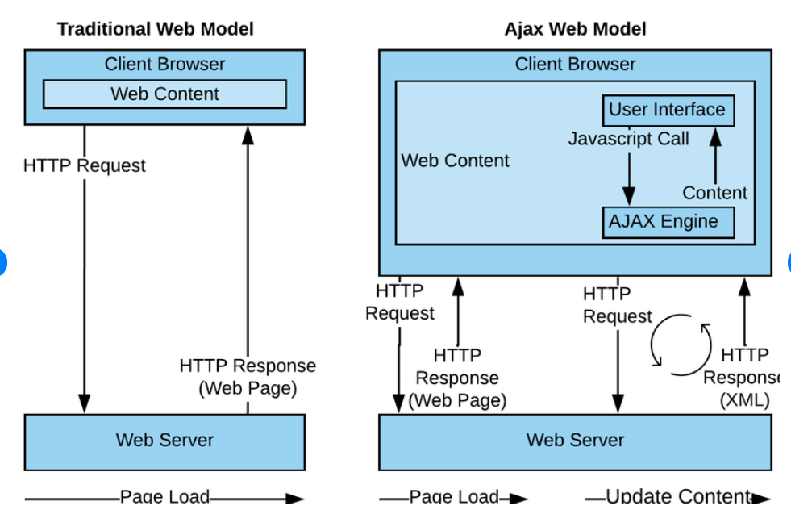

Slide 8
Where AJAX is used?
Form submissions without page reload
Loading dynamic content (news, comments)
Real-time chat apps
Data filtering/search suggestions

Slide 9
Concepts of AJAX
Synchronous vs Asynchronous communication
Web Request-Response Basics
JavaScript's role in AJAX

Slide 10
Synchronous vs Asynchronous (Real Life)
Synchronous: Wait at counter
Asynchronous: Order & continue working

Slide 11
Code Examples
Synchronous: alert() blocks
Asynchronous: setTimeout() non-blocking

Slide 12
Web Communication Basics
Client sends HTTP Request
Server sends HTTP Response
AJAX sends without full reload

Slide 13
Role of JavaScript
Creates XMLHttpRequest or Fetch
Sends GET/POST requests
Handles server response
Updates webpage dynamically

Slide 14
Example 1: Async Server Message
Controller returns delayed message
AJAX sends GET asynchronously
UI remains usable

Slide 15
Example 2: Return JSON Data
Controller returns JSON object
AJAX parses JSON and displays

Slide 16
Example 3: Loading Indicator
Shows 'Loading...' while waiting
Handles success/error cleanly

Slide 17
Recap: What You Practiced
Async communication
Requests to MVC Controller
Using JSON in AJAX
JavaScript DOM updates

Slide 18
Part 3: Technical Foundations
What is XMLHttpRequest?
Making an AJAX GET Request
Making an AJAX POST Request
Common errors to avoid
Mini project idea

Slide 19
What is XMLHttpRequest?
JS object to interact with server
Send and receive data asynchronously
Basis of traditional AJAX

Slide 20
AJAX GET Request (Example)
Create XMLHttpRequest object
Open connection with method GET
Send request
Process server response

Slide 21
Sample AJAX GET Code
var xhr = new XMLHttpRequest();
xhr.open('GET', '/Controller/Action', true);
xhr.onreadystatechange = function() { /* handle response */ };
xhr.send();

Slide 22
AJAX POST Request (Example)
Create XMLHttpRequest object
Open connection with POST
Set request headers
Send form data

Slide 23
Sample AJAX POST Code
var xhr = new XMLHttpRequest();
xhr.open('POST', '/Controller/Action', true);
xhr.setRequestHeader('Content-Type', 'application/x-www-form-urlencoded');
xhr.send('key1=value1&key2=value2');

Slide 24
Common AJAX Errors
Cross-Origin Request blocked (CORS)
Wrong Content-Type header
Invalid JSON parsing

